Slide 1
MVC 5
(Model-View-Controller)
Uvod
Notes:
Prije početka pitati za iskustva koja polaznici imaju oko MVC 4.

Slide 2
ASP.NET Arhitektura na IIS-u
Authentication
Basic
NTLM
Anon
Determine Handler
CGI
Authentication
Static File
Forms
Windows
ISAPI
ASPX
Map Handler
Trace
Send Response
Log
Compression
. . .
Notes:
Do not go into too much detail about the different building blocks. It would be useful to walk the students through a scenario, such as a user logging into a website showing which blocks are used and why. Do not spend much time on CGI, Tracing or compression. This is primarily an architecture slide.
Module 1: Overview of Web Application Design
Course 10264A

Slide 3
ASP.NET 4.0 arhitektura
Caching
Pages
Profile
Intrinsics
Modules
Controls
Roles
Handlers
Globalization
Master/Layout Pages
Identity
Notes:
The goal of this slide is to reinforce the different building blocks of the ASP.NET 4.0 architecture. Students should already be familiar with most of these terms. Mention that a detailed description of each is in their notes. Highlight any .NET Framework 4.0 differences.
Module 1: Overview of Web Application Design
Course 10264A

Slide 4
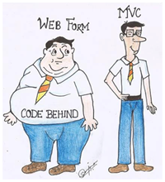
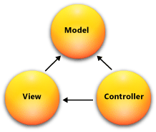
Što je MVC Framework?
MVC je način dizajniranja softvera
(M)odel
(V)iew
(C)ontroller
Notes:
Spend some time describing the basics of the MVC framework. Stress that the students will be going into more detail in modules 3, 4 and 5.
Question: What advantages are there in separating the concerns of data structures, presentation, and application logic?
Potential Answer: Separation of concerns allows for autonomous updates, and easier maintenance.
Module 1: Overview of Web Application Design
Course 10264A

Slide 5
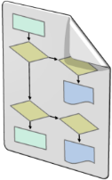

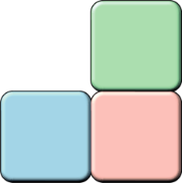
Pregled MVC-a
ASP.NET MVC radna okolina je strukturirana, visoko testabilna, radna okolina koja integrira sve dobre značajke ASP.NET radne okoline.
MVC radna okolina uključuje slijedeće komponente:
Models
Model je kontejner podataka. Model objekti su dijelovi aplikacija koji implementiraju logiku vezanu na aplikacijsku podatkovnu domenu.
Views
View-ovi su komponente koje prikazuju aplikacijsko korisničko sučelje (UI ili GUI).
Controllers
Controller-i su komponente koje rukuju i obrađuju akcije na korisničkom sučelju. Oni obrađuju modele i prikazuju ih na View-oovima.
Notes:
Poll the students to find out their level of understanding of MVC. If the students understand the concepts, this may be review, if not, spend time explaining the different aspects of MVC. If an internet connection is available, show examples.

Slide 6
Klijent – Server komunikacija
Web Server - IIS
Baza podataka – SQL, Entity Framework
ASP.NET MVC – radna okolina, Razor View Engine, Helpers, ...
Serverski kod - C#, LINQ
Request (Zahtjev)
Browser (preglednik)
GUI – HTML, CSS
Klijetski kod – Java Script, AngularJS
Response (Odgovor)
Notes:
Do not go into too much detail about the different building blocks. It would be useful to walk the students through a scenario, such as a user logging into a website showing which blocks are used and why. Do not spend much time on CGI, Tracing or compression. This is primarily an architecture slide.
Module 1: Overview of Web Application Design
Course 10264A

Slide 7
Životni ciklus MVC Request-a
Browser
URL Routing
Controller
Model
View
POST
new
Invoke method
Invoke action
Lookup view
Render (viewData)
HTML
Notes:
This material will most likely be new to the students. Spend some time going over an MVC request. Do not spend time comparing an MVC request with a Web Forms request as this is covered in the next slide.
Question: What is the first step of an MVC request?
Answers: ASP.NET Routing routes the request to the appropriate resource.
Module 1: Overview of Web Application Design
Course 10264A

Slide 8
Razmatranja prilikom dizajna
Sigurnost (Security)
Skalabilnost i pouzdanost (Scalability and Reliability)
Search Engine Optimization (SEO)
Lokalizacija (Localization)
Dostupnost (Accessibility)
Notes:
This would be great place for a group discussion, and should follow the discussion found in Slide 4. Go through two or three website examples, and discuss how each one of the design considerations apply.
Question: How does security play a role in every type of web application?
Answer: Even for static websites, the file system should have security attached.
Question: How do scalability and reliability relate to one another?
Answer: Often scalability and reliability are closely linked, as the ability to recover from the loss of resources requires the ability of your web application to spread its processing across more than one single point of failure.

